Slide 1

Futures Institute
Year | Avg. | Total
2010 | 2.0 | 1.3 M
2015 | 2.2 | 1.5 M
2020 | 2.5 | 1.9 M
Tracking Report on FP2020 Core Indicators, Indonesia: 2012 & 2013
Bob Magnani
Jakarta
17 October 2014

Slide 2
Indicators reported annually for all FP2020 countries
Indicator 1a: Contraceptive Prevalence Rate, Modern Methods (mCPR)
Indicator 1b: Percent distribution of modern contraceptive users by method
Indicator 2: Number of additional modern contraceptive users
Indicator 3: Percent of women whose demand for modern contraception is satisfied
Indicator 4: Percentage of women with an unmet need for modern contraceptive methods
Indicator 5: Annual expenditure on family planning
Indicator 6: Couple-Year of Protection (CYP)

Slide 3
Indicators that model impact for all FP2020 countries
Indicator 7: Number of unintended pregnancies
Indicator 8: Number of unintended pregnancies averted due to contraceptive use
Indicator 9: Number of maternal deaths averted due to contraceptive use
Indicator 10: Number of unsafe abortions averted due to contraceptive use

Slide 4
Indicators reported annually for a subset of 10 countries and for all FP2020 countries in years with a DHS
Indicator 11: Percent of women who were provided with information on family planning during their last visit with a health service provider
Indicator 12: Mean score on Method Information Index
Indicator 13: Percent of women who make family planning decisions alone or jointly with their husband/partner
Indicator 14: Adolescent birth rate
Indicator 15: Percent informed of permanence of sterilization

Slide 5
Practical difficulties measuring indicators
Problem | Proposed Solution
(1) Data for currently-married women only (MWRA) | (a) Use adjustment factors (b) Modify UNPD Model and FPET to produce estimates for WRA
(2) No annual survey data | (a) Use routine data (e.g., contraceptive commodities data) (b) Estimate using FPET
(3) No country-specific data for key parameters of impact indicators | Use country data that are available and global/regional averages to fill gaps

Slide 6
Summary: FP2020 Core Indicators and Estimation Tools/Approaches
Indicators Reported Annually for all Track20 Countries Indicator 1. Contraceptive Prevalence Rate, Modern Methods (mCPR), All Women Indicator 2. Total number of contraceptive users by method Indicator 3. Percent of women whose demand for modern contraception is satisfied (met need for contraception) Indicator 4. Percentage of women with an unmet need Indicator 5. Annual expenditure on family planning from government domestic budget Indicator 6. Couple-Years of Protection (CYP) | Indicators that Model Impact for all Track20 Countries Indicator 7: Number of unintended pregnancies Indicator 8: Number of unintended pregnancies averted due to contraceptive use Indicator 9: Number of maternal deaths averted due to contraceptive use Indicator 10: Number of unsafe abortions averted due to contraceptive use | Indicators Reported in Years with a DHS or PMA2020 Survey Indicator 11: Percent of women who were provided with information on family planning during their last visit with a health service provider Indicator 12: Score on Method Information Index Indicator 13: Percent of women who make family planning decisions alone or jointly with their husband/partner or jointly with provider Indicator 14: Adolescent birth rate Indicator 15: Percent informed of permanence of sterilization.
Family Planning Estimation Tool
Secondary Analysis of DHS Data
Impact Estimation Tool

Slide 7
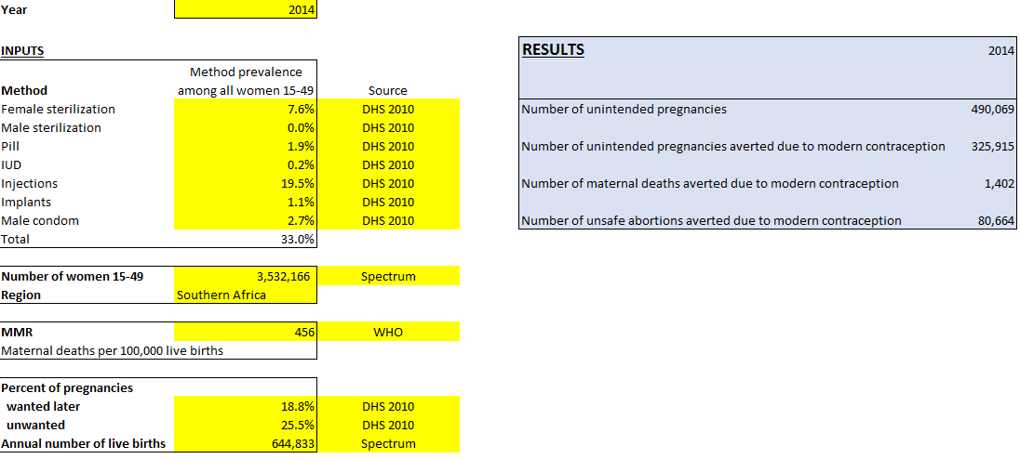
Track20 Impact Indicator Tool
Enter data in yellow boxes
See results in blue box

Slide 8
Methods of Estimating/Projecting mCPR in Years After the Last DHS

Slide 9
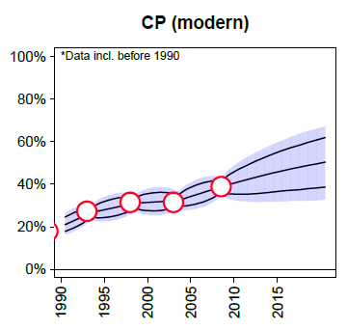
UN Population Division Estimates and Projections
Source: Alkema L, Kantorova V, Menozzi C, Biddlecom A. National, regional,
and global rates and trends in contraceptive prevalence and unmet need for family
planning between 1990 and 2015: a systematic and comprehensive analysis. Lancet
2013; published online March 12. http://dx.doi.org/10.1016/S0140-6736(12)62204-1.

Slide 10
UNPD Methods
Bayesian hierarchical model
Logistic growth curve models the trend from low to high CPR
mCPR_{t} = P / ( 1 + e^{-ω x (t – Ω)})
Time series model captures deviations from smooth trend

Slide 11
Logistic Trend for mCPR
mCPR_{t} = P / ( 1 + e^{-ω x (t – Ω)})
P
asymptote
ω
pace
Ω
mid-year

Slide 12
Fitting to Survey Data
mCPR_{t} = P / ( 1 + e^{-ω x (t – Ω)})
ω = 0.15
P = 0.46
Ω = 1987

Slide 13
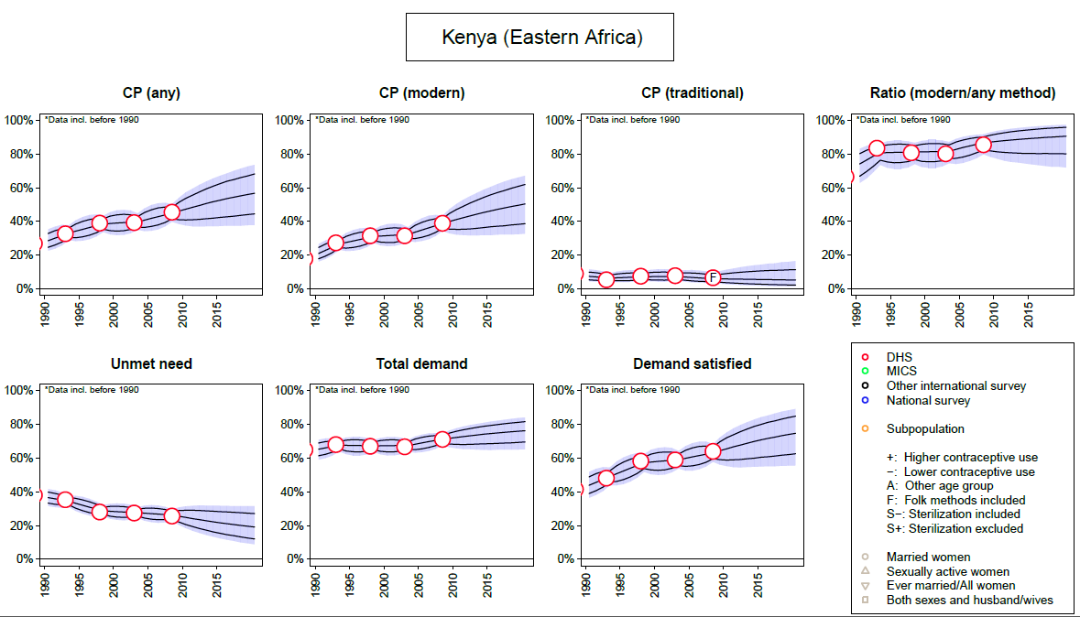

Slide 14
Indonesia: Options for Estimating mCPR in Years After the Last DHS
SUSENAS
BkkbN Annual Survey (to be discontinued?)
PMA2020 Rapid Survey (beginning in 2014)
Service Statistics (contraceptive commodities distributed to clients)
Modeling (UNPD/FPET)

Slide 15
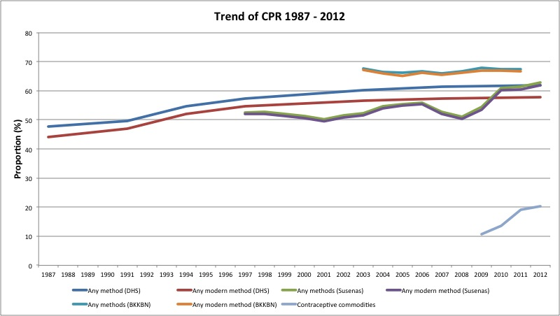
National survey estimates of mCPR, Indonesia 1987-2012

Slide 16
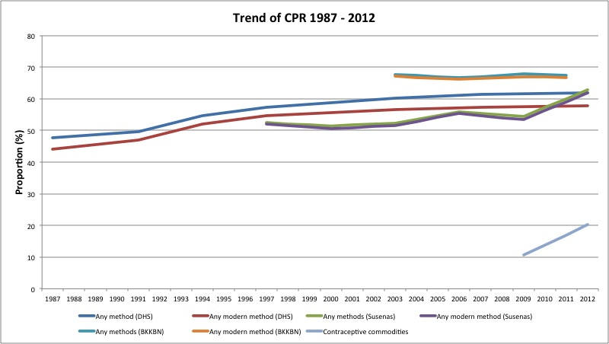
National survey estimates of mCPR, Indonesia 1987-2012 (Smoothed)

Slide 17
Indonesia: FPET Results for 2012 & 2013

Slide 18
Indicator Estimates for 2012 & 2013
See data sheets for indicator estimates and methodology notes

Slide 19
Thank You
Questions?

